Slide 1
Building, Maturing & Rocking a Security Operations Center
Brandie Anderson
Sr. Manager, Global Cyber Security Threat & Vulnerability Management
Hewlett-Packard

Slide 2
Agenda
To be or Not to be…
What is a SOC?
Use Case Creation
People
Process & Procedure
Documentation
Workflow
Metrics
I don’t want to grow up
Rocking a SOC
Questions

Slide 3
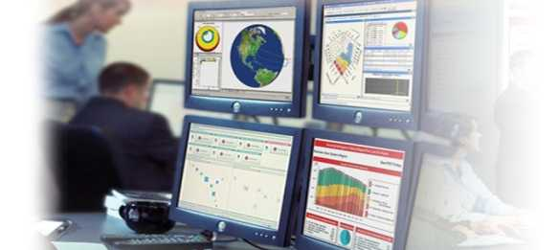

To be or
Not to be…
Building a SOC is a business decision
  Organization size
  Compliance factors
  Reduce the impact of an incident
  ROI
  Proactive reaction

Slide 4
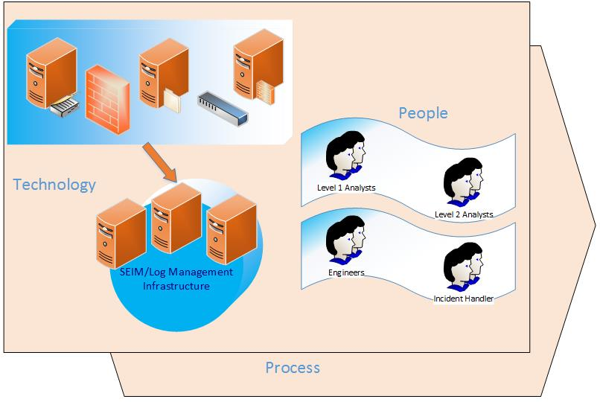
What is a SOC?
Through people, processes and technology, a SOC is dedicated to detection, investigation, and response of log events triggered through security related correlation logic

Slide 5
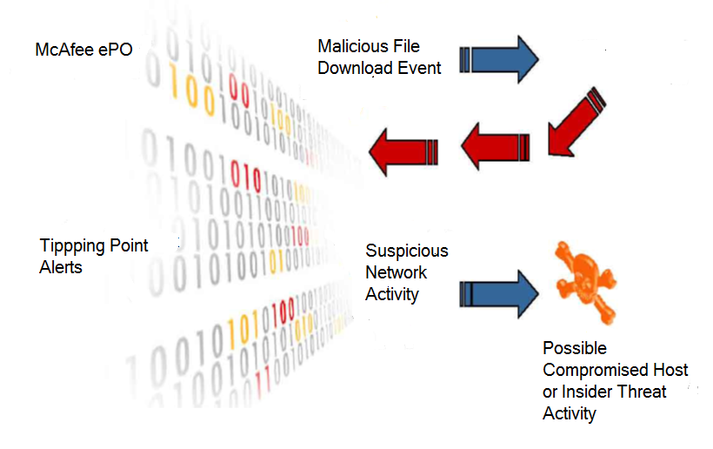

ArcSight Correlation

Slide 6
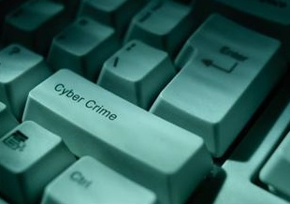
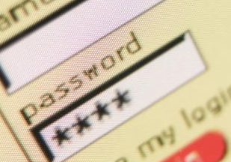
Use Case Creation
2012: The year malware surged 'dramatically‘
91% of Targeted Attacks Start with Spear-phishing Email
Large-Scale Water Holing Attack Campaigns Hitting Key Targets
Microsoft's Patch Tuesday Leaves Out Crucial Internet Explorer Fix
Cyberattacks Against U.S. Corporations Are on the Rise
Adobe Data Breach Exposes Military Passwords

Slide 7
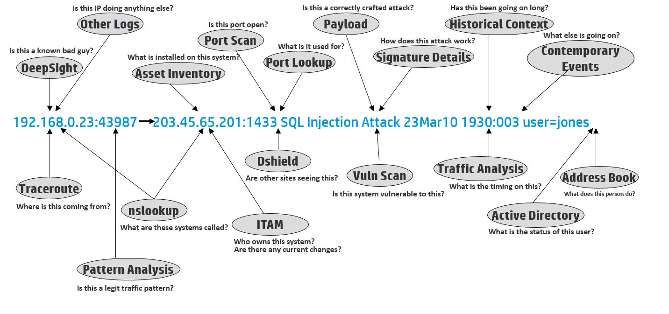
People

Slide 8
Roles and Responsibilities
Level-1 and Level-2 Analysts
Operations Lead
Incident Handler
SEIM Engineer
Content Developer
SOC Manager
Staffing Models
Establishing coverage
Determining the right number of resources
  8x5 = Min 2 Analyst w/ on-call
  12x5/7 = Min 4-5 Analysts w/on-call
  24x7 = Min 10-12 Analysts
Finding the right skills
Ensuring on-shift mentoring
Continuous improvement
  Resource Planning
Security Device Engineers
System Administrators
Network Administrators
Physical Security

Slide 9
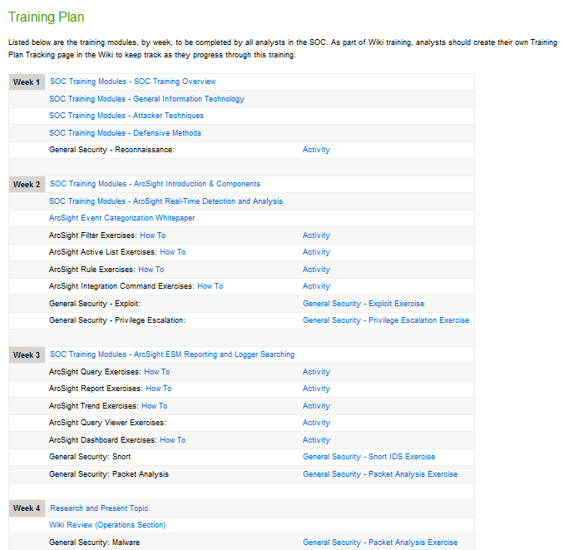
Training
Information security basics
On-the-job training
SEIM training
SANS GCIA and GCIH
Career development
Avoiding burnout
Providing challenges
Outlining career progression
  Exactly how do I get from level 1 to level 2 to lead, etc
  Skill assessments
  Certifications

Slide 10
Process & Procedure
Business & Technology
Access Management
Architecture
Compliance
DR/BCP
Process Improvement
Use Cases
Operational
Call Out
Case Management
Event Handling
Monitoring
On-boarding
Shift Log
Shift Turn Over
Triage
Analytical
Event Analysis
Incident Response
Reporting
Research
Threat Intelligence

Slide 11
Documentation Repository Choices
Microsoft SharePoint
Pro
  Approved by Policy
  Already deployed, supported both internal & by Microsoft
  Integrates with Active Directory & MS Office
  Allows for Calendars, Task Assignment, Notifications, Document Revision Tracking
Con
  Complicated to use
  Typically hard to find information (search)
  Not very flexible
  No real revision
  control
File Shares
Pro
  Everyone has MS Office
  Everyone knows how to use a file share
  Does not require specific technology knowledge
Con
  Cluttered
  Overlap of information
  Nearly impossible to search for information
  Requires someone in charge of upkeep
  No revision control
Wiki
Pro
  Open Source
  Editor utilizes Markup Language (HTML-like)
  Easy to Search
  Malleable
  Revision Control
  Plugins allow extensive customization
Con
  Open Source
  Not Vendor supported

Slide 12
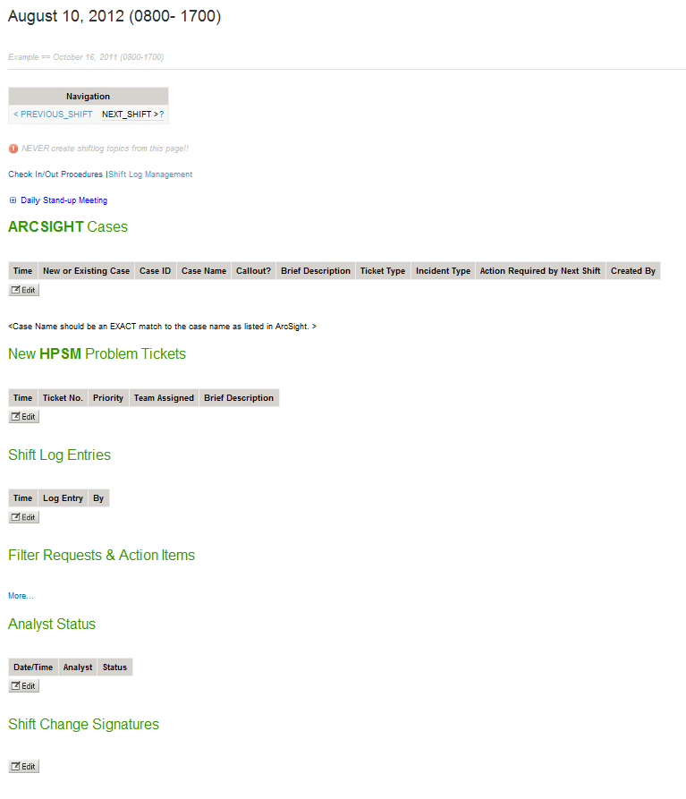
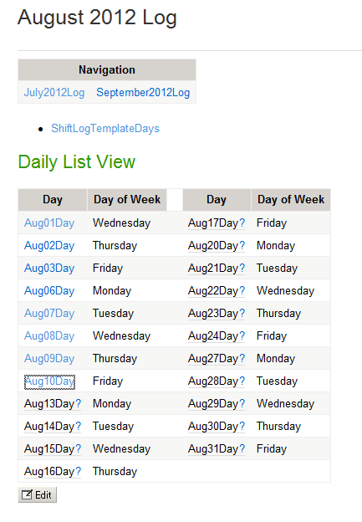

Slide 13
Workflows
Event
Incident
Case
SOC
Departmental
Organizational

Slide 14
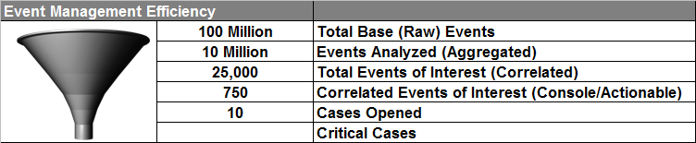
Metrics
  How many events are coming in?
    Raw Events
    How many data endpoints are
    collected / monitored
    How may different types of data
    How many use cases
  What is coming out?
    Correlated Events
    Incidents / Cases
  How quickly are things handled?
    Event recognition
    Event escalation
    Event resolution
  Further defined
    Per hour/day/week/month
    Per analyst
    Per hour of day/ per day of week
    Incident / case category / severity

Slide 15
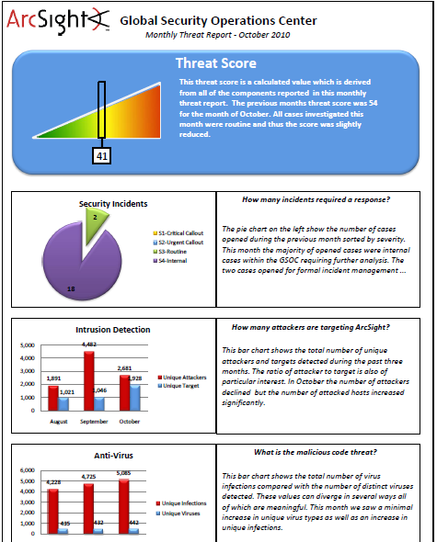
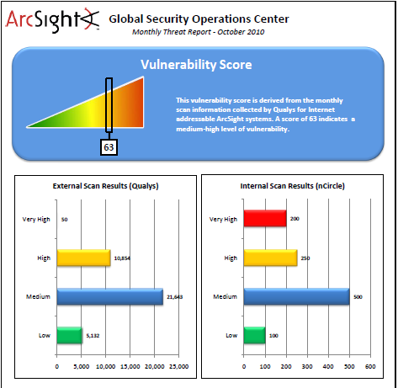
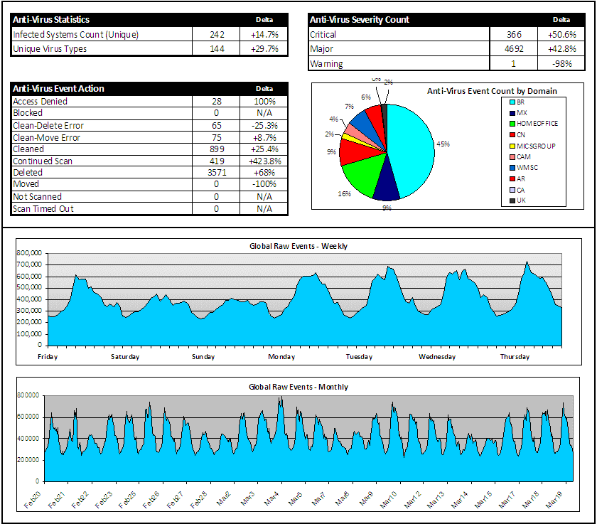
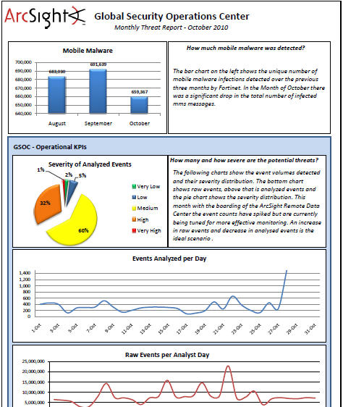
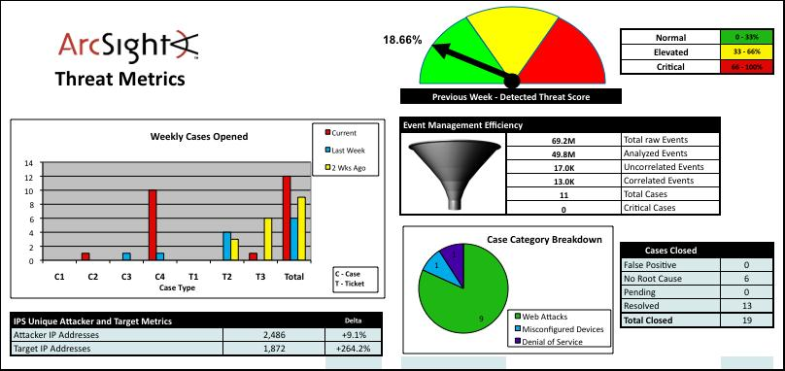
Maturing
Understand the 80/20 rule
Leverage metrics
Expand senior leader dashboard view
Institute CMM methodology
Monitor organizational health
Increase complexity

Slide 16
CMM Example
According to the book Pragmatic Security Metrics – Applying Metametrics to Information Security*, an information security version of the Capability Maturity Model (CMM) looks loosely like this:
“Level 1: Ad hoc: information security risks are handled on an entirely informational basis. Processes are undocumented and relatively unstable.
Level 2: Repeatable but intuitive: there is an emerging appreciation of information security. Security processes are not formally documented, depending largely on employee’s knowledge and experience.
Level 3: Defined process: information security activities are formalized throughout the organization using policies, procedures, and security awareness.
Level 4: Managed and measurable: information security activities are standardized using policies, procedures, defined and assigned roles and responsibilities, etc., and metrics are introduced for routing security operations and management purposes.
Level 5: Optimized: Metrics are used to drive systematic information security improvements, including strategic activities.”
*Brotby & Hinson, 2013 p. 47
CMM – Capability Maturity Model is registered to Carnegie Mellon University

Slide 17
Rocking It
Preparation
Identification
Containment
Eradication
Recovery
Lessons Learned

Slide 18
Questions

Slide 19
Thank you!

